Slide 1
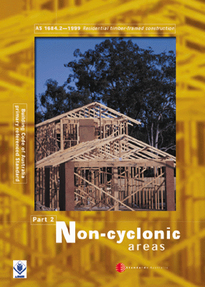
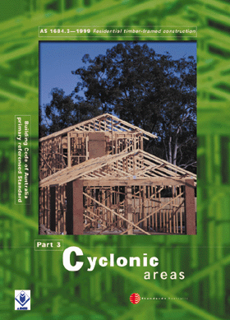
SECTION 1 -
SCOPE AND GENERAL

Slide 2
1.1 SCOPE
This Standard specifies requirements for building practice and the selection, placement and fixing of the various structural elements used in the construction of timber-framed Class 1 and Class 10 Buildings as defined by the Building Code of Australia and within the limitations given in Clause . The Standard also applies to alterations and additions to these buildings.

Slide 3
Building Classes
Class 1(a) - Detached house
Attached dwellings
(Terrace houses, Villas etc.)
Class 1(b) - Boarding house
• not more than 300 sq. mtrs
• not more than 12 residents
Class 10 - Outbuildings
(garages, carports etc.)

Slide 4
1.1 SCOPE (cont’d)
This Standard also provides building practice and procedures, which assist in the correct specification and determination of timber members, bracing and connections, thereby minimizing the risk of creating an environment which might adversely affect the ultimate performance of the structure.
A2

Slide 5
1.1 SCOPE (cont’d)
This Standard may also be applicable to the design and construction of other classes of buildings where the design criteria, loadings and other parameters applicable to those classes of building are within the limitations of this Standard.

Slide 6
Other Building Classes
Class 2 - Building containing 2 or more
sole occupancy units.
Class 3 - Boarding house, Guest house etc.
    • For aged, disabled, children
    • Residential part of hotel, motel,
    school, health care building.
Class 4 - The residential part of a
Class 5,6,7,8,9 building.

Slide 7
Other Building Classes
Class 5 - Offices
Class 6 - Shops
Class 7 - Storage, Carparks
Class 8 - Factories, Workshops
Class 9 - Public Buildings

Slide 8
1.1 SCOPE (cont’d)
NOTES:
1 See AS 1684.1 for details of design criteria, loadings and other parameters.
2 Whilst this Standard can be used to design Class 10 buildings, less conservative levels of design for this building class may be permitted by building regulations and other Australian Standards.

Slide 9
1.3 USE OF ALTERNATIVE MATERIALS OR METHODS
This Standard does not preclude the use of framing, fastening or bracing methods or materials other than those specified. Alternatives may be used, provided they satisfy the requirements of the Building Code of Australia.
A4

Slide 10
1.6 LIMITATIONS
Generally the limitations given in AS 1684 apply because of the limits of the design information given in AS 1684.
e.g. - the bracing tables given in the standard are limited to a 16 m wide building and 35^{O} roof pitch.

Slide 11
1.6.1 General
The information contained in this Standard is provided specifically for conventional timber-framed buildings and is applicable to single-and two-storey construction built within the limits or parameters given in Clauses 1.6.2 to 1.6.10 and Figure 1.1.

Slide 12
1.6.1 General
‘Conventional timber framed buildings’ may also include post and beam, and pole frame buildings, however, depending on the design, some components of such buildings may fall outside the scope of AS 1684.
e.g. for a pole frame building, the pole size and footing requirements if these poles are used as cantilevered bracing poles.

Slide 13
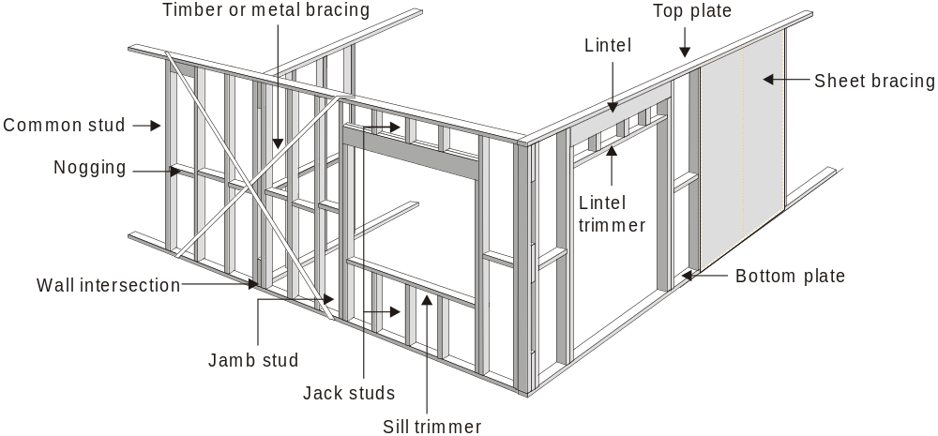
Conventional Frame

Slide 14
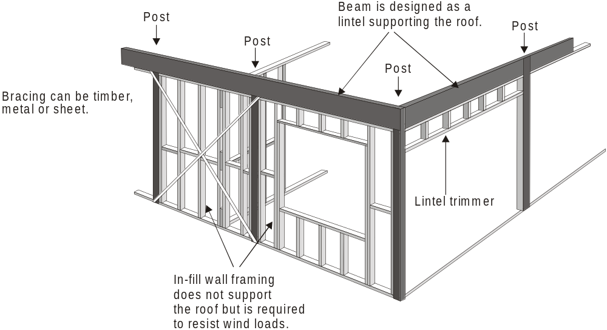
Post & Beam

Slide 15
1.6.2 Wind Classification
Either AS 4055 - Wind Loads for Housing (the simplified wind classification standard) or AS 1170.2 SAA Loading code Part 2 – Wind loads shall be used to determine the wind classification necessary for the use of this Standard.

Slide 16
1.6.2(a) Wind Classification
Where the wind classification is determined from AS 4055, the maximum building height limitation of 8.5m given in AS 4055 shall apply to this Standard.
The height limitation of 8.5 m to the ridge applies when using AS 4055 because this height is used by AS 4055 to determine the appropriate wind classification.

Slide 17
1.6.2(a) Wind Classification
NOTE:-
All other height restrictions given in AS 4055 such as the 6 m to the eaves and the 2.7 m wall height will not apply to AS 1684.
These restrictions are only relevant to the bracing and tie-down force tables given in AS 4055.

Slide 18
1.6.2(b) Wind Classification
Where AS 1170.2 is used to determine the maximum design gust wind speed, a wind classification shall be adopted in accordance with Table 1.1.
The ultimate limit state design gust wind speed determined from AS 1170.2 shall not be more than 5% greater than the ultimate limit state wind speed given in Table 1.1 for the corresponding wind classification adopted.

Slide 19
1.6.2(b) Wind Classification
If AS 1170.2 is used to determine the wind classification there is no building height restriction.
Note: Town planning generally limits the height of most domestic buildings.

Slide 20
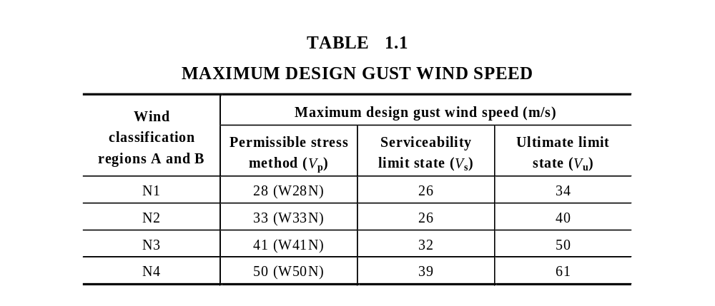
1.6.2 Wind Classification
Non-cyclonic

Slide 21
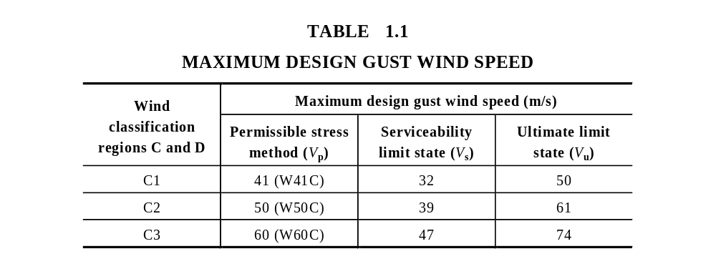
1.6.2 Wind Classification
Table 1.1 - Cyclonic
Cyclonic

Slide 22
1.6.3 Plan
Building shapes shall be essentially rectangular, square, L-shaped or a combination of essentially rectangular elements including splayed-end and boomerang-shaped buildings.
There is no major limitation on the shape of buildings. Exceptions may include dome shaped buildings.

Slide 23
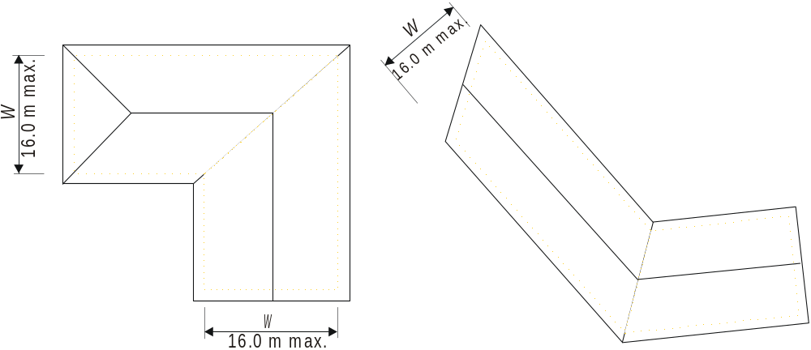
1.6.3 Plan
FIGURE 1.1 (b) Plan

Slide 24
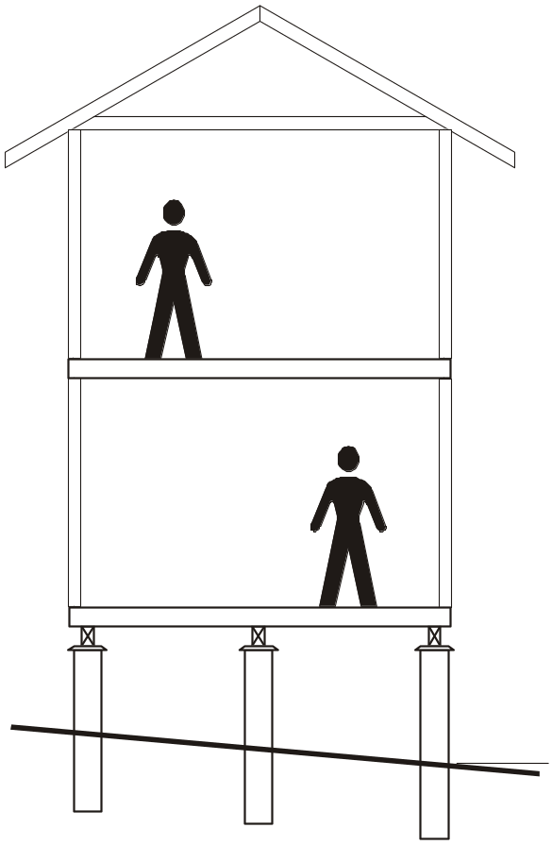
1.6.4 Number of storeys
The maximum number of storeys of timber framing shall not exceed two.
The building shown opposite is considered to be ‘two storeys of timber framing’.
See comments Section 2 - Clause 2.7.8 for more information.

Slide 25
1.6.5 Width
The maximum width of building shall be 16000 mm, excluding eaves.
This limitation on width only limits the distance between the ‘pitching points’ of the roof.
NOTE: The geometric limits of the span tables often will limit the width.

Slide 26
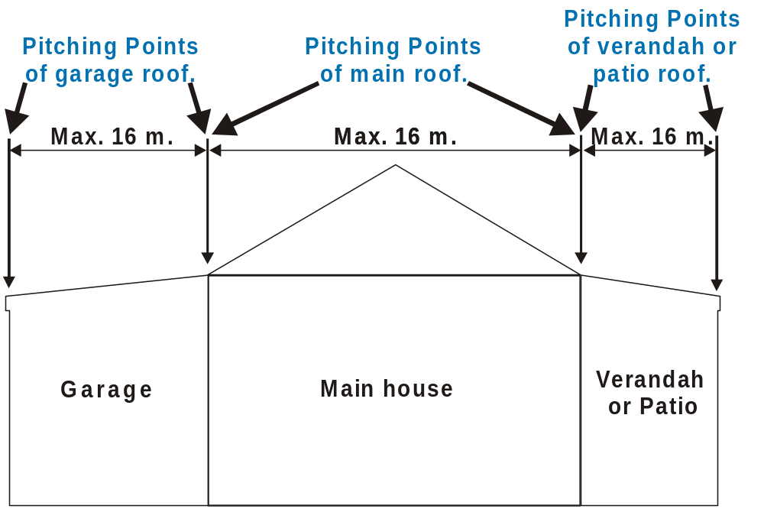
Use of the timber span tables may also limit this width. e.g. the timber span tables only cater for Roof Load Widths up to 7.5 m. Refer Section 2.6 for more details on RWL.

Slide 27
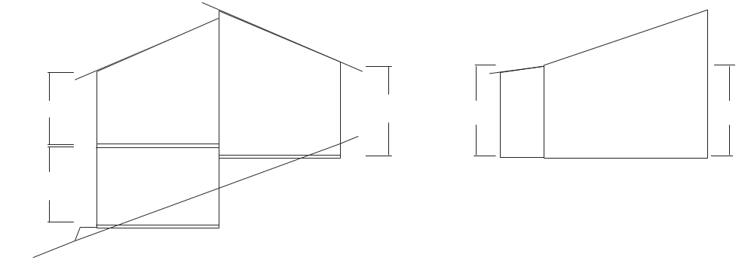
1.6.6 Wall height
The maximum wall height shall be 3000 mm (floor to ceiling) as measured at common external walls, i.e. not gable or skillion ends. (see Figure 1.1)

Slide 28
1.6.6 Wall height
NOTES:
1 The Span Tables for studs given in the Supplements provide for stud heights in excess of 3000 mm to cater for gable, skillion and some other design situations where wall heights, other than those of common external walls, may exceed 3000 mm.
A2

Slide 29
1.6.6 Wall height
NOTES: (cont)
2 Building height limitations apply where wind classification is determined using AS 4055 (see Clause 1.6.2).
A2
The limitation of 8.5 m to ridge is used by AS 4055 to determine the wind speed so if the wind classification is determined using AS 4055 this limitation will apply.
The 2.7m wall height limit of AS 4055 is because the bracing tables given in AS 4055 are limited to 2.7m. Unless you are using these tables for bracing calculations the 2.7 m wall height limitation will NOT apply.

Slide 30
1.6.6 Wall height
NOTES: (cont)
3 The provisions contained in this Standard may also be applicable to houses with external wall heights up to 3600 mm where appropriate consideration is given to the effect of the increased wall height on racking forces, reduction to bracing wall capacities, overturning and uplift forces, shear forces and member sizes.
A4

Slide 31
AS 1684
USER GUIDE
G U I D E T O T H E U S E O F AS 1684
External Wall Heights
from 3.0m to 3.6m
4
The following AS1684 User Guide 4 gives the recommended procedure for determining the racking, overturning forces etc. required where wall heights are from 3000 to 3600 mm.

Slide 32
AS 1684
USER GUIDE
G U I D E T O T H E U S E O F AS 1684
External Wall Heights
from 3.0m to 3.6m
4
Background
Figure 1.1 and Clause 1.6.6 in AS 1684 Parts 2 and 3 require a maximum external wall height (floor to ceiling) of 3000 mm. The span table supplements to the code, on the other hand, provide stud sizes for heights up to 4800 mm where permitted for the relevant size and grade of stud.

Slide 33
AS 1684
USER GUIDE
G U I D E T O T H E U S E O F AS 1684
External Wall Heights
from 3.0m to 3.6m
4
The overriding 3000 mm height limitation was included in the Code to ensure that other design assumptions and requirements inherent in the Code would not be compromised. These included the basis for determination of the racking and overturning forces and the resistance of nominal connections and bracing materials including uplift at ends of bracing walls and the magnitude of shear forces.

Slide 34
AS 1684
USER GUIDE
G U I D E T O T H E U S E O F AS 1684
External Wall Heights
from 3.0m to 3.6m
4
It was recognised that if the Code could be extended to cater for wall heights up to 3600 mm (the old 12 ft ceilings), that this would increase its value particularly with respect to renovations and extensions to older housing stock.

Slide 35
AS 1684
USER GUIDE
G U I D E T O T H E U S E O F AS 1684
External Wall Heights
from 3.0m to 3.6m
4
Sensitivity Checks
Prior to determining the "rules" that would permit the Code to be applied to 3600 mm high walls, a sensitivity check was carried out to determine the effect these higher walls would have on the remainder of the code.

Slide 36
AS 1684
USER GUIDE
G U I D E T O T H E U S E O F AS 1684
External Wall Heights
from 3.0m to 3.6m
4
Clause 8.3.4 Total racking force is a function of area of elevation and racking pressures (the maximum wall height assumed to generate the pressures given in Tables 8.1 to 8.5 was 2700 mm even though it was permitted to be used for walls up to 3000 mm high). The pressures in Tables 8.1 to 8.5 are a function of the building geometry such as height to width ratio.

Slide 37
AS 1684
USER GUIDE
G U I D E T O T H E U S E O F AS 1684
External Wall Heights
from 3.0m to 3.6m
4
It was found that increasing the assumed external wall heights from 2700 mm to 3600 mm increased a significant percentage of the pressures on the projected areas of elevation.

Slide 38
AS 1684
USER GUIDE
G U I D E T O T H E U S E O F AS 1684
External Wall Heights
from 3.0m to 3.6m
4
Clause 8.3.6.4 - Wall capacity and height modification. An increase from 4200 mm to 4800 mm was considered appropriate as the span table output extends to this height to cater for internal walls in houses with cathedral ceilings.

Slide 39
AS 1684
USER GUIDE
G U I D E T O T H E U S E O F AS 1684
External Wall Heights
from 3.0m to 3.6m
4
Note: The modified (reduced) bracing capacity (kN/m) should be used in conjunction with Table 8.23 (Table 8.24 in Part 3) when determining the uplift force at the end of bracing walls.

Slide 40
AS 1684
USER GUIDE
G U I D E T O T H E U S E O F AS 1684
External Wall Heights
from 3.0m to 3.6m
4
Clause 8.3.6.10 Fixing of bottom of bracing walls requires consideration of the uplift at ends of bracing walls which in turn is a function of wall height. Table 8.23 (Table 8.24 in Part 3) therefore requires extension to cater for walls up to 4800 mm high.

Slide 41
AS 1684
USER GUIDE
G U I D E T O T H E U S E O F AS 1684
External Wall Heights
from 3.0m to 3.6m
4
Note: This extension was also required irrespective of the information in this guide note for walls to 3600 mm.

Slide 42
AS 1684
USER GUIDE
G U I D E T O T H E U S E O F AS 1684
External Wall Heights
from 3.0m to 3.6m
4
Clause 9.6.4 The net wind uplift pressures in Table 9.5 and the uplift forces in Tables 9.6 to 9.11 (Tables 9.6 to 9.10 in Part 3) may be influenced by the overturning forces on the building (see note to Table 9.5). The overturning forces are caused by a combination of both direct uplift and the lateral forces on the building. The taller the building, then the higher the overturning forces will be.

Slide 43
AS 1684
USER GUIDE
G U I D E T O T H E U S E O F AS 1684
External Wall Heights
from 3.0m to 3.6m
4
An investigation of the overturning forces indicated that the equivalent net uplift pressures were significantly higher for taller buildings (3600 mm high external walls).

Slide 44
AS 1684
USER GUIDE
G U I D E T O T H E U S E O F AS 1684
External Wall Heights
from 3.0m to 3.6m
4
Clause 9.7 and Table 9.26 Shear Forces. No change is required to this clause as the method for calculating the shear force requires the force obtained from Table 9.26 to be multiplied by the projected height of the building which will automatically take into account greater wall heights.

Slide 45
AS 1684
USER GUIDE
G U I D E T O T H E U S E O F AS 1684
External Wall Heights
from 3.0m to 3.6m
4
Clause 9.7.6 and Table 9.29 Shear forces on external non-load-bearing walls. Additional notes to Table 9.29 are required to cater for external wall heights of 3300 mm and 3600 mm.

Slide 46
AS 1684
USER GUIDE
G U I D E T O T H E U S E O F AS 1684
External Wall Heights
from 3.0m to 3.6m
4
Appendix G The bracing force values given in the tables in this Appendix are only applicable to wall heights of 2700mm. It is not appropriate to apply a simple % increase to cater for wall heights from 3000 mm to 3600 mm, therefore this Appendix should not be used for walls higher than 3000mm.

Slide 47
AS 1684
USER GUIDE
G U I D E T O T H E U S E O F AS 1684
External Wall Heights
from 3.0m to 3.6m
4
Recommended Procedure for Wall Heights 3000 mm to 3600 mm
1. Member Sizes
Single or Upper Storey Construction
The size of studs, plates and lintels in external load-bearing walls can be determined directly from the relevant span tables in the supplements to AS 1684 Part 2 and Part 3.

Slide 48
AS 1684
USER GUIDE
G U I D E T O T H E U S E O F AS 1684
External Wall Heights
from 3.0m to 3.6m
4
1. Member Sizes
Lower Storey of Two Storey Construction
The span tables in the supplements to AS 1684 Part 2 and Part 3 only extend to a maximum wall height of 3000 mm. Stud sizes for wall heights greater than 3000 mm will therefore need to be specifically engineered. This can be easily achieved using published computer software such as 'Timber Solutions".

Slide 49
AS 1684
USER GUIDE
G U I D E T O T H E U S E O F AS 1684
External Wall Heights
from 3.0m to 3.6m
4
2. Racking Force
The total racking force shall be determined from Clause 8.3.4 but for external wall heights above 3000 mm up to 3600 mm, the lateral pressures determined from Tables 8. 2 to 8.5 for roof pitches 50 to 200 shall be increased by 10%.
Note:- Pressures for other roof pitches or for vertical surface elevations (Table 8.1) do not require to be increased.

Slide 50
AS 1684
USER GUIDE
G U I D E T O T H E U S E O F AS 1684
External Wall Heights
from 3.0m to 3.6m
4
Determine the capacity of bracing walls greater than 2700 mm high from Table 8.19. For 4800 mm high walls, the bracing wall capacity/height multiplier is 0.56.

Slide 51
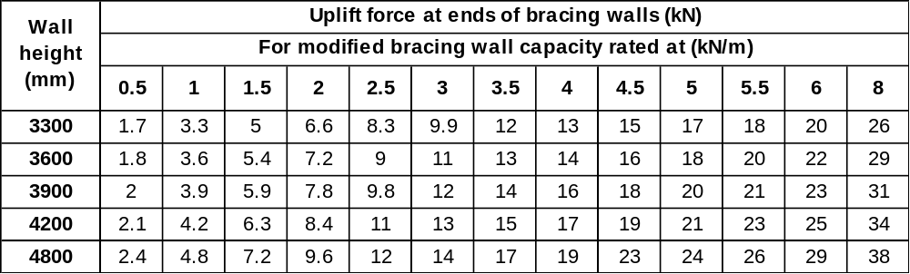
AS 1684
USER GUIDE
G U I D E T O T H E U S E O F AS 1684
External Wall Heights
from 3.0m to 3.6m
4
3. Fixing of Bottom of Bracing Walls
Include the following additional lines in
Table 8.23 of Part 2 and Table 8.24 of Part 3:-

Slide 52
AS 1684
USER GUIDE
G U I D E T O T H E U S E O F AS 1684
External Wall Heights
from 3.0m to 3.6m
4
Example: the modified bracing wall capacity for a 3.6 m high brace as per Table 8.18 Method B would be – 6.0 kN/m x 0.75 (Table 8.19) = 4kN/m. Therefore the uplift force required at the ends of this bracing wall is 14 kN.

Slide 53
AS 1684
USER GUIDE
G U I D E T O T H E U S E O F AS 1684
External Wall Heights
from 3.0m to 3.6m
4
4. Wind Uplift Forces
In Clause 9.6.4, the wind uplift forces calculated by multiplying the net uplift pressure by the area of roof contributing to tie-down, shall be determined from Table 9.5 using the following net uplift pressures for the tie-down positions described:-

Slide 54
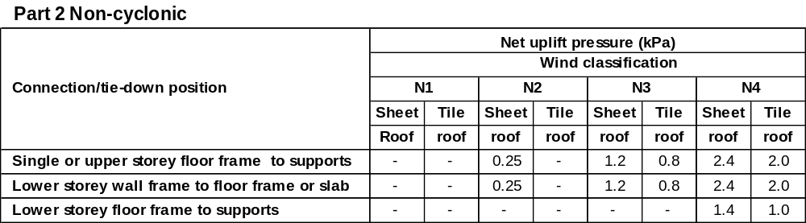
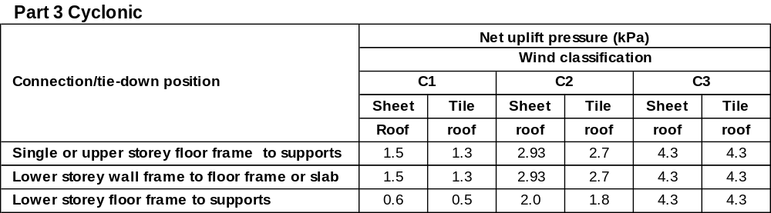
AS 1684
USER GUIDE
G U I D E T O T H E U S E O F AS 1684
External Wall Heights
from 3.0m to 3.6m
4

Slide 55
AS 1684
USER GUIDE
G U I D E T O T H E U S E O F AS 1684
External Wall Heights
from 3.0m to 3.6m
4
4. Wind Uplift Forces
Note:- The uplift forces given in Tables 9.6 to 9.10 shall not be used for determination of uplift forces however, they could be recalculated using the net uplift pressures given above.

Slide 56
AS 1684
USER GUIDE
G U I D E T O T H E U S E O F AS 1684
External Wall Heights
from 3.0m to 3.6m
4
5. Shear Forces on External Non-load- bearing Walls
Add the following NOTES to Table 9.29 to cater for 3300 mm and 3600 mm high walls:-
NOTES: For 3300 mm high external walls, multiply the above values by 1.2.
for 3600 mm high external walls, multiply the above values by 1.3.

Slide 57
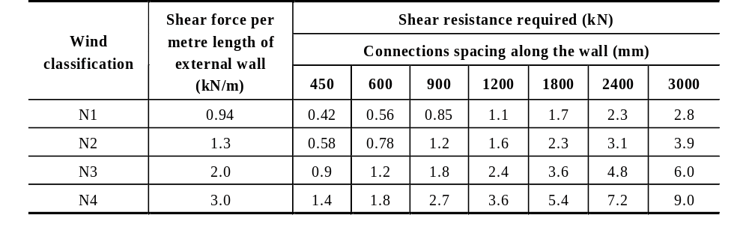
AS 1684
USER GUIDE
G U I D E T O T H E U S E O F AS 1684
External Wall Heights
from 3.0m to 3.6m
4
TABLE 9.29
SHEAR WIND FORCES AT THE TOP OF EXTERNAL WALLS
UP TO 2700 mm HIGH
NOTES: For 3300 mm high external walls, multiply the above values by 1.2.
for 3600 mm high external walls, multiply the above values by 1.3.

Slide 58
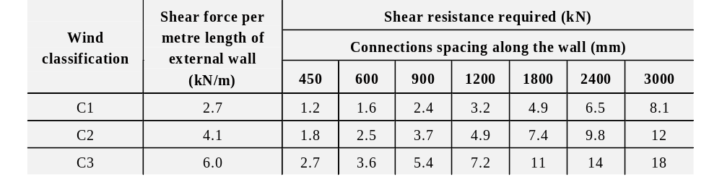
AS 1684
USER GUIDE
G U I D E T O T H E U S E O F AS 1684
External Wall Heights
from 3.0m to 3.6m
4
TABLE 9.29
SHEAR WIND FORCES AT THE TOP OF EXTERNAL WALLS
UP TO 2700 mm HIGH
NOTES: For 3300 mm high external walls, multiply the above values by 1.2.
for 3600 mm high external walls, multiply the above values by 1.3.

Slide 59
AS 1684
USER GUIDE
G U I D E T O T H E U S E O F AS 1684
External Wall Heights
from 3.0m to 3.6m
4
6. Appendix G (RACKING FORCES)
Appendix G shall not be used to determine racking forces for wall heights from 3000 to 3600mm

Slide 60
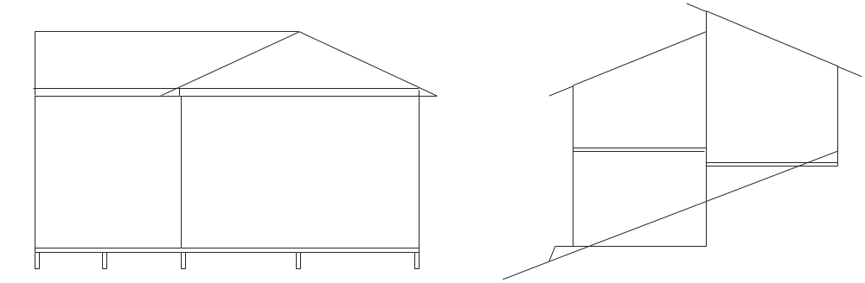
1.6.7 Roof Pitch
The maximum roof pitch shall be 35° (70:100).
35^{O}
35^{O}

Slide 61
1.6.8 Spacing of bracing
For single or upper storey The spacing of bracing elements, measured at right angles to elements, shall not exceed 9000 mm. for N1 & N2. For wind classifications N3, N4, C1, C2 & C3 the spacing of bracing elements is determined in accordance with Clause 8.3.6.7

Slide 62
1.6.8 Spacing of bracing
For the lower storey of two storey or subfloor of single or two storey construction, bracing walls shall be spaced in accordance with Clause 8.3.5.9.

Slide 63
1.6.8 Spacing of bracing
NOTE: Bracing walls may be spaced greater than 9000 mm or the prescribed limits where the building is designed and certified in accordance with engineering principles

Slide 64
1.6.9 Roof types
Roof construction shall be hip, gable, skillion, cathedral, trussed or pitched or in any combination of these.

Slide 65
1.6.10 Building Masses
Building masses appropriate for the member being designed shall be determined prior to selecting and designing from the Span Tables in the Supplements.
Where appropriate, the maximum building masses relevant to the use of each member Span Table are noted under the Table.

Slide 66
1.6.10 Building Masses (cont’d)
For the design of most timber members, other than ‘rafters, purlins, intermediate beams, ridge beams and underpurlins’ for pitched and cathedral roofs, selecting a Sheet roof or a Tile roof will be all that is required to ‘determine the appropriate building mass’.

Slide 67
1.6.10 Building Masses (cont’d)
Where a table asks for an input of ‘Tile Roof’ or ‘Sheet Roof’, the maximum mass assumed by the table is 40 kg per square metre for a Sheet roof and 90 kg per square metre for a Tile roof.

Slide 68
1.6.10 Building Masses (cont’d)
For rafters or purlins, intermediate beams, ridge beams and underpurlins, for pitched and cathedral roofs, the appropriate roof masses (weight) for various members will need to calculated using Appendix B of AS 1684.

Slide 69
1.6.10 Building Masses (cont’d)
For rafters or purlins, the ‘supported materials’ will include the weight of the roofing material, roof battens, sarking and/or insulation plus ceiling battens and ceiling sheeting for a cathedral roof.
The mass of a member being considered has been accounted for in the design of that member.

Slide 70
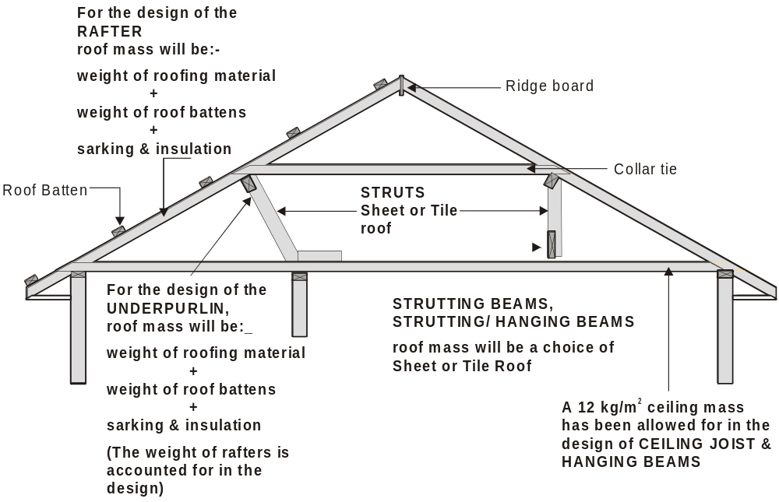

Slide 71
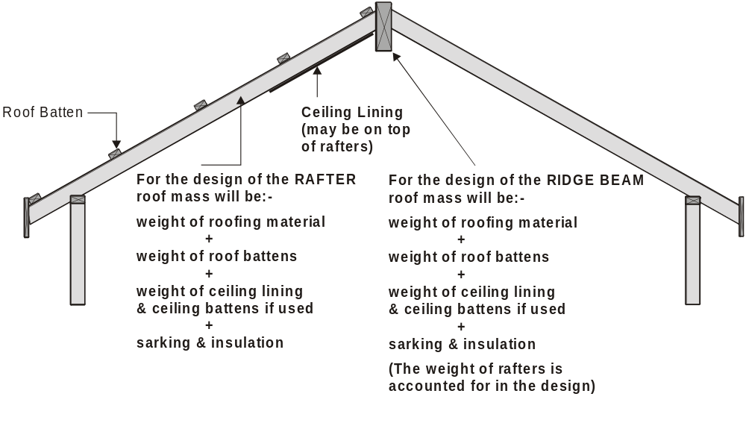

Slide 72
1.7 DESIGN CRITERIA
The following includes the design criteria that has been used in the preparation of this Standard:

Slide 73
1.7 DESIGN CRITERIA (cont’d)
(a) The basis of the design used in the preparation of this Standard is AS 1684.1 and AS 1720.1.

Slide 74
1.7 DESIGN CRITERIA (cont’d)
AS 1684.1 - Design Criteria
This standard sets out the engineering design methods, assumptions and other design criteria which have been used in the preparation of the Span Tables, Uplift Forces and Racking Pressures (bracing) contained within AS 1684.2, AS1864.3 & AS1684.4.

Slide 75
1.7 DESIGN CRITERIA (cont’d)
AS 1720.1 - Timber structures
Part 1: Design methods
This standard provides designers and manufacturers of timber structures with limit state design methods, design data and testing procedures of timber structures.

Slide 76
1.7 DESIGN CRITERIA (cont’d)
(b) The design dead, live, and wind loadings recommended in AS 1170.1, AS 1170.2 and AS 4055, were taken into account in the member computations, with appropriate allowances for the distribution of concentrated or localized loads over a number of members where relevant.
See also Clause 1.6.2.

Slide 77
1.7 DESIGN CRITERIA (cont’d)
AS 1170.1 - 1989 Loading Code
Part 1: Dead and live loads
Part 2: Wind loads
These standards set out the requirements for establishing the minimum dead, live and wind loads as well as load combinations to be used in the limit state design of structures and members.

Slide 78
1.7 DESIGN CRITERIA (cont’d)
NOTE: Construction supporting vehicle loads is outside the scope of this Standard.

Slide 79
1.7 DESIGN CRITERIA (cont’d)
(c) All pressures, loads, forces and capacities given in this Standard are based on limit state design.

Slide 80
1.7 DESIGN CRITERIA (cont’d)
When framing or fastening methods or materials other than those specified’ (Clause 1.3) are used, in particular methods or materials used for bracing and tie-down, and their capacity (strength) is not based on limit state design, these framing or fastening methods or materials are not compatible with this standard.
Manufacturers data based on permissible stress design should be converted to limit state before using it with this standard.

Slide 81
1.7 DESIGN CRITERIA (cont’d)
(d) The member sizes, bracing and connection details are suitable for construction (including timber-framed brick veneer) of design category H1 and H2 domestic structures in accordance with AS 1170.4.
This Standard AS 1684 does not provide specifications for unreinforced masonry construction subject to earthquake loads.

Slide 82
1.7 DESIGN CRITERIA (cont’d)
(e) The effects of snow loads up to 0.2 kPa on member sizes, bracing and connection details have been accommodated in the design.
AS 1170 Part 3 - Snow loads
This standard defines the geographical locations where a 0.2kPa is applicable. Please refer to this standard for further information.

Slide 83
1.8 FORCES ON BUILDINGS
The design of framing members may be influenced by the wind forces that act on the specific members. When using Span Tables in the Supplements, the appropriate wind classification (e.g. N2) together with the stress grade shall be established prior to selecting the appropriate supplement to obtain timber member sizes.

Slide 84
1.8 FORCES ON BUILDINGS (cont’d)
Statements expressed in mandatory terms in Notes to the Span Tables are deemed to be requirements of this Standard.
All framing members shall be adequately designed and joined to ensure suitable performance under the worst combinations of dead, live, wind and earthquake loads. Members shall also meet serviceability requirements for their application

Slide 85
1.8 FORCES ON BUILDINGS (cont’d)
Assumptions used for forces, load combinations and serviceability requirements of framing members are given in AS 1684.1.
Figure 1.2 indicates forces applied to timber-framed buildings that shall be considered.

Slide 86
1.8 FORCES ON BUILDINGS (cont’d)
The main forces acting on buildings are:
Dead Loads - the forces arising from the weight of the building components themselves.
Live Loads - the forces arising from the weight of persons using the building and moveable furniture.
Wind Loads - the forces arising from - gales, thunderstorms & tropical cyclones.

Slide 87
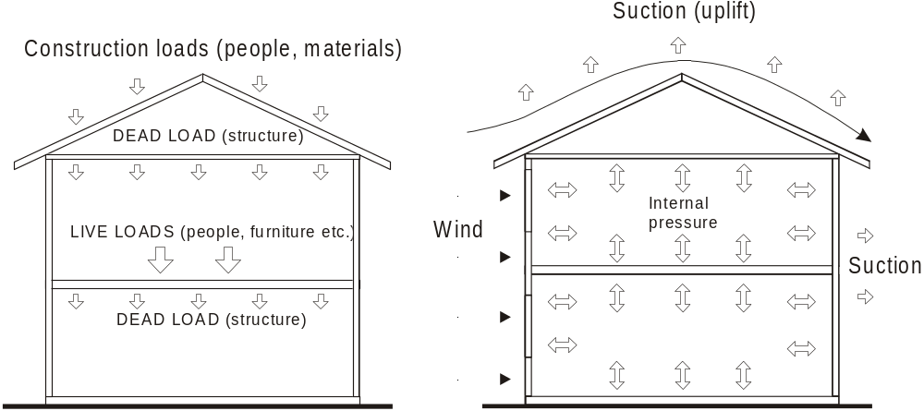
(a) Gravity loads (b) Uplift wind loads
NOTE: For clarity, earthquake and snow loads are not shown (see Clause 1.7 ).
FIGURE 1.2 LOADS ON BUILDINGS

Slide 88
1.8 FORCES ON BUILDINGS (cont’d)
Forces on buildings produce different effects on a structure. Each effect shall be considered individually and be resisted.
Figure 1.3 summarizes some of these actions.
This Standard takes account of these.

Slide 89
RACKING force is resisted by BRACING.
Racking
(wall deformation)

Slide 90
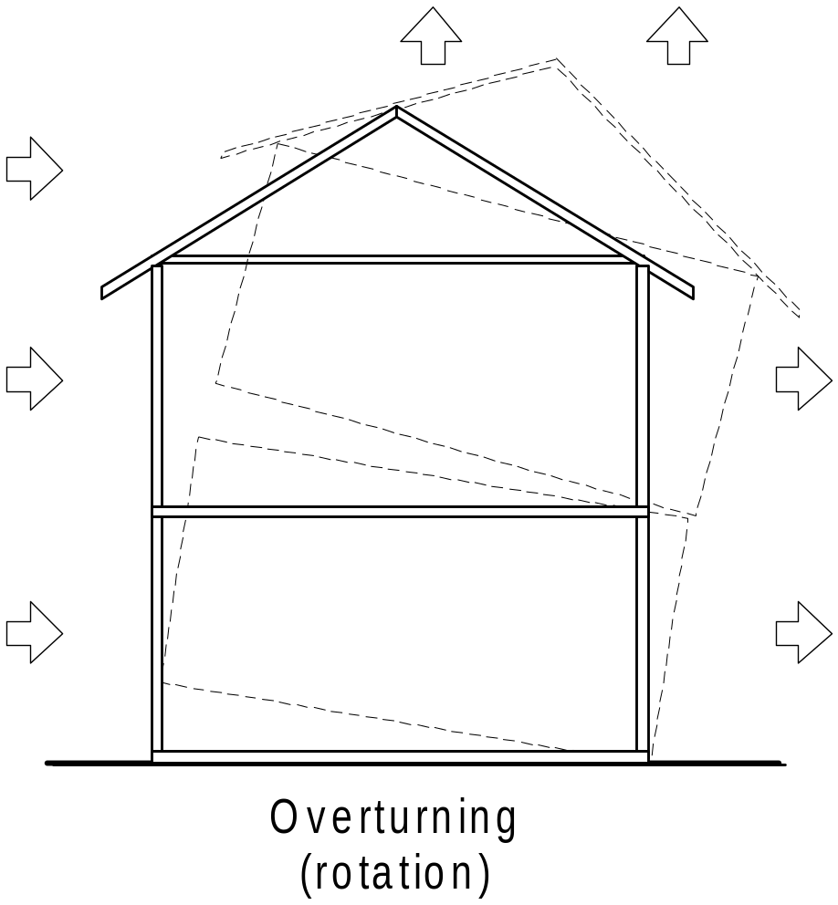
OVERTURNING is resisted by
NOMINAL and/or
TIE-DOWN CONNECTIONS.

Slide 91
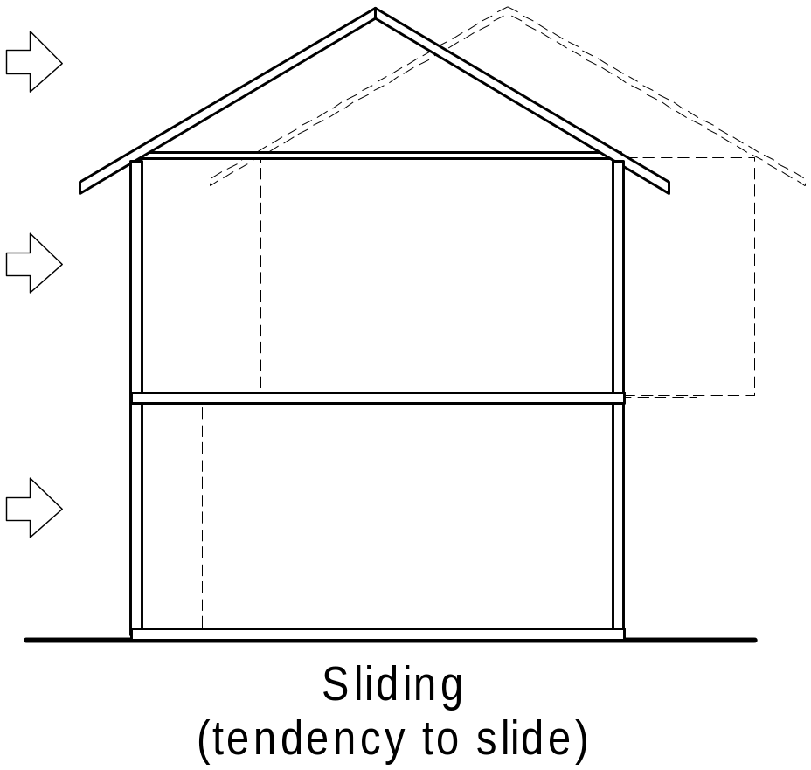
SLIDING (Shear Forces) is resisted by
NOMINAL and/or
TIE-DOWN CONNECTIONS and in some situations extra fixings.

Slide 92
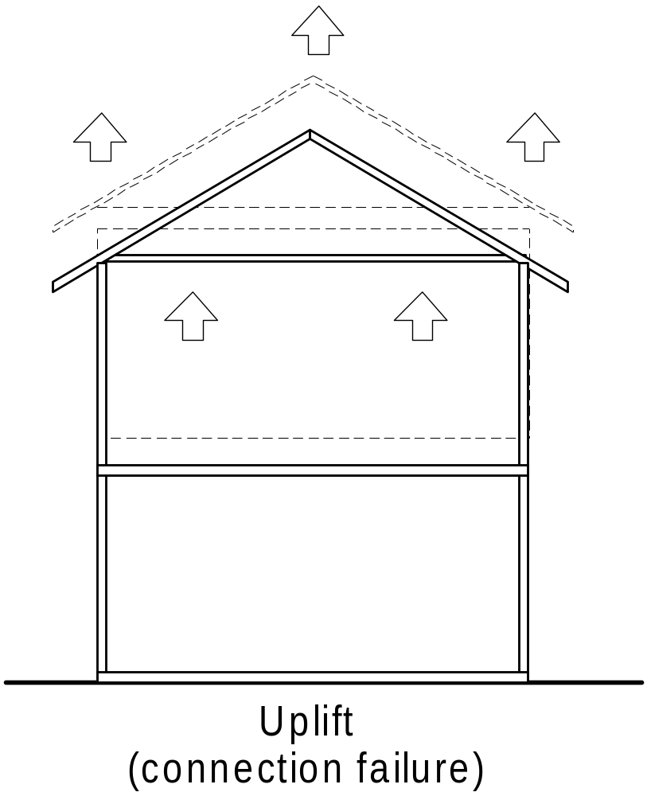
UPLIFT is resisted by NOMINAL and/or
TIE-DOWN CONNECTIONS.

Slide 93
1.8 FORCES ON BUILDINGS (cont’d)
Because wind forces are generally the the most critical for structural members, engineering design for houses is centred around wind forces.
For the purpose of design, these forces are resolved into:
horizontal forces on the walls and roofs
uplift forces (or downward forces) on the ceiling and roof

Slide 94
1.9 LOAD PATHS OFFSETS AND CANTILEVERS
Roof loads ceiling loads, wall loads and floor loads shall, where applicable, be transferred through the timber frame to the footings by the most direct route.
For floor framing, the limitations imposed regarding the support of point loads and the use of offsets and cantilevers are specified in Section 4.

Slide 95
1.9 LOAD PATHS OFFSETS AND CANTILEVERS (cont’d)
NOTES:
1 This load path in many cases cannot be maintained in a completely vertical path, relying on structural members that transfer loads horizontally. Offset or cantilevered floor framing supporting loadbearing walls may also be used (see Figures 1.4 and 1.5).

Slide 96
1.9 LOAD PATHS OFFSETS AND CANTILEVERS (cont’d)
2 Floor members designed as ‘supporting floor load only’ may support a loadbearing wall (walls supporting roof loads) where the loadbearing wall occurs directly over a support or is within 1.5 times the depth of the floor member from the support (see also to Clause 4.3.1.3 and Clause 4.3.2.3).

Slide 97
1.9 LOAD PATHS OFFSETS AND CANTILEVERS (cont’d)
3. Other members supporting roof or floor loads where the load occurs directly over the support or is within 1.5 times the depth of the member from the support do not require to be designed for that load.

Slide 98
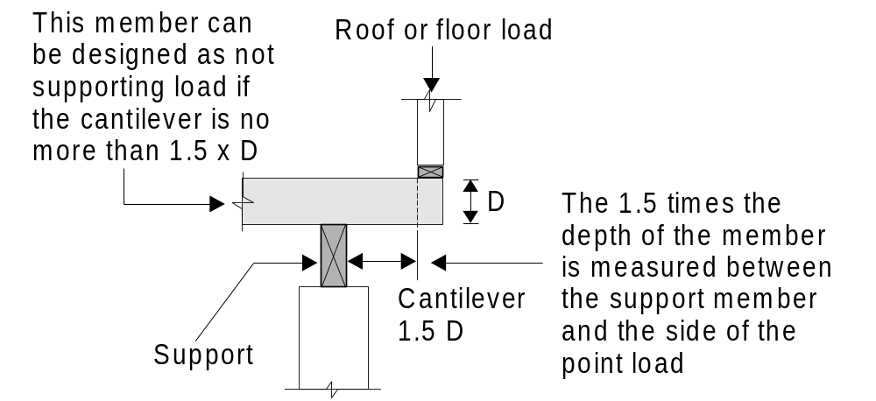
This may be any member that supports roof and/or floor loads

Slide 99
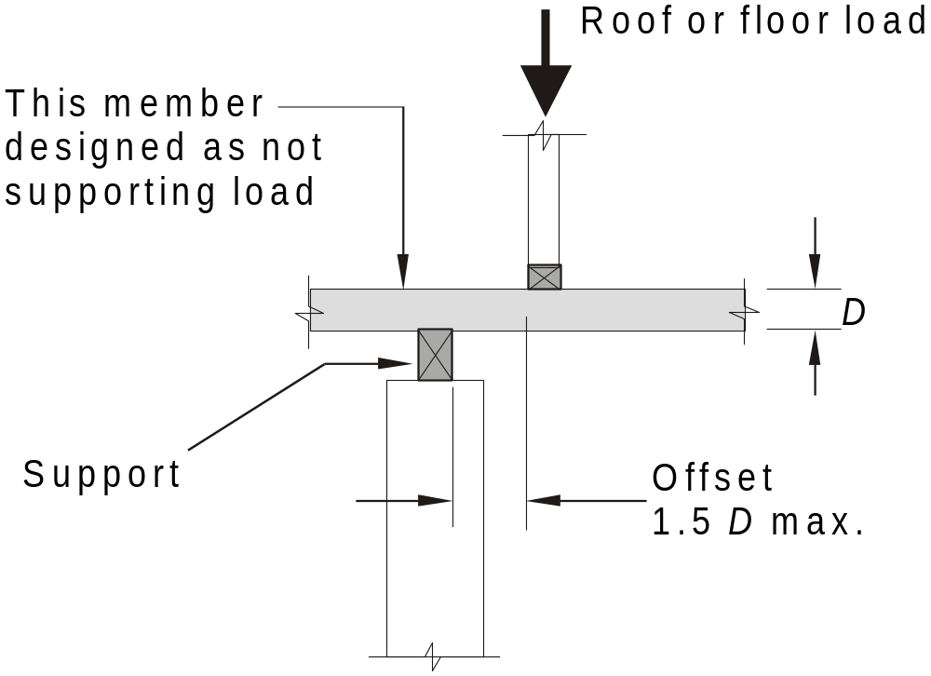
This may be any member that supports roof and/or floor loads

Slide 100
In a timber frame, loads are frequently taken to the foundations through horizontal members designed to transfer these loads, such as roof beams, hanging & strutting beams, lintels, floor joist and bearers.
As these horizontal members concentrate the loads at their ends, care must be taken to ensure that, if these concentrated loads are in turn supported by another horizontal member, that this member is designed accordingly.

Slide 101
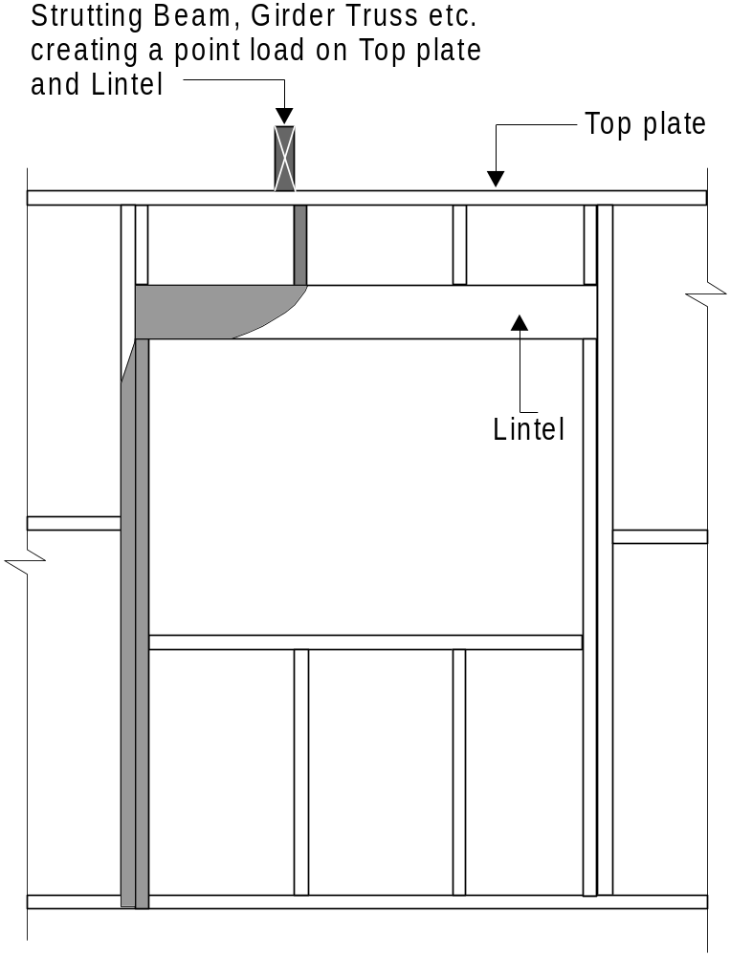
An example of this is where a strutting beam or girder truss is supported by a lintel. This lintel needs to be designed for this point load. The jamb studs will also need to be designed to carry this extra load as well as the structure that supports these jamb studs.

Slide 102
1.10 DURABILITY
Structural timber used in accordance with this Standard shall have the level of durability appropriate for the relevant climate and expected service life and conditions including exposure to insect attack or to moisture which could cause decay.

Slide 103
1.11 DIMENSIONS
Timber dimensions throughout this Standard are stated by nominating the depth (the dimension that carries the load) of the member first followed by its breadth (see Figure 1.6); e.g. 90 × 35 mm (studs, joists etc.), 45 × 70 (wall plates, battens, etc.)

Slide 104
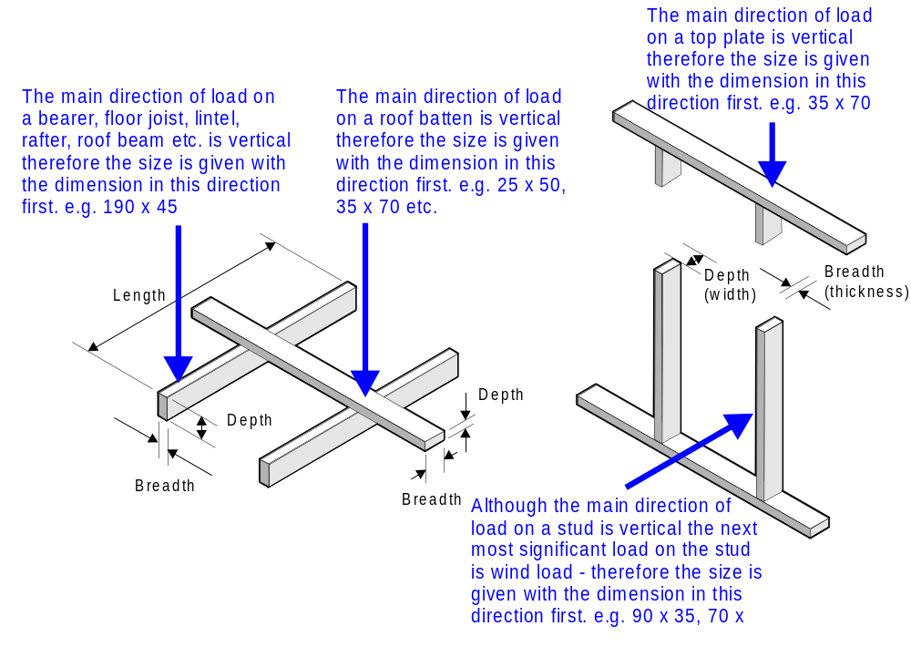

Slide 105
1.12 BEARING
The minimum bearing for specific framing members (bearers, lintels, hanging beams, strutting beams, combined strutting / hanging beams, counter beams, combined counter/strutting beams and verandah beams) shall be as given in the Notes to the Span Tables of the Supplements, as appropriate.

Slide 106
1.12 BEARING
In all other cases, except for battens, (roof and ceiling battens) framing members shall bear on to their supporting element, a minimum of 30 mm at their ends or 60 mm at the continuous part of the member, by their full breadth (thickness).
Reduced bearing area shall only be used where additional fixings are provided to give equivalent support to the members.
A3

Slide 107
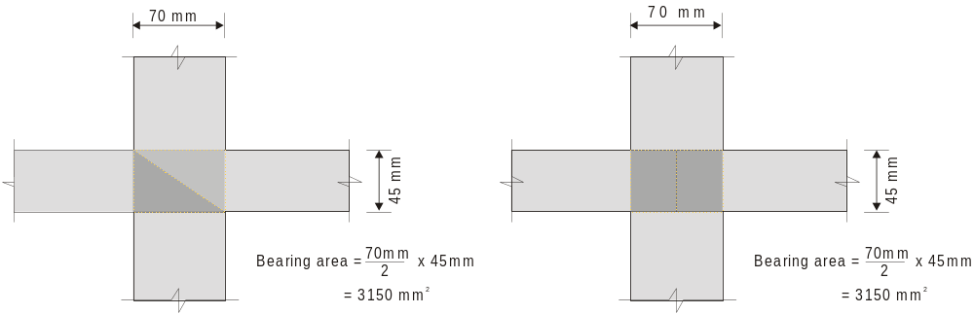
1.12 BEARING
Where the bearing area is achieved using a non-rectangular area such as a splayed joint, the equivalent bearing area shall not be less than that required above.

Slide 108
1.13 STRESS GRADES
All structural timber used in conjunction with this Standard shall be stress graded in accordance with the relevant Australian Standard.
All structural timber to be used in conjunction with this Standard shall be identified in respect of stress grade.

Slide 109
1.13 STRESS GRADES
Note:
The timber stress grade is usually designated alphanumerically (e.g. F17, MGP12). Stress grades covered by Span Tables in the Supplements to this Standard are given in Table 1.2.

Slide 110
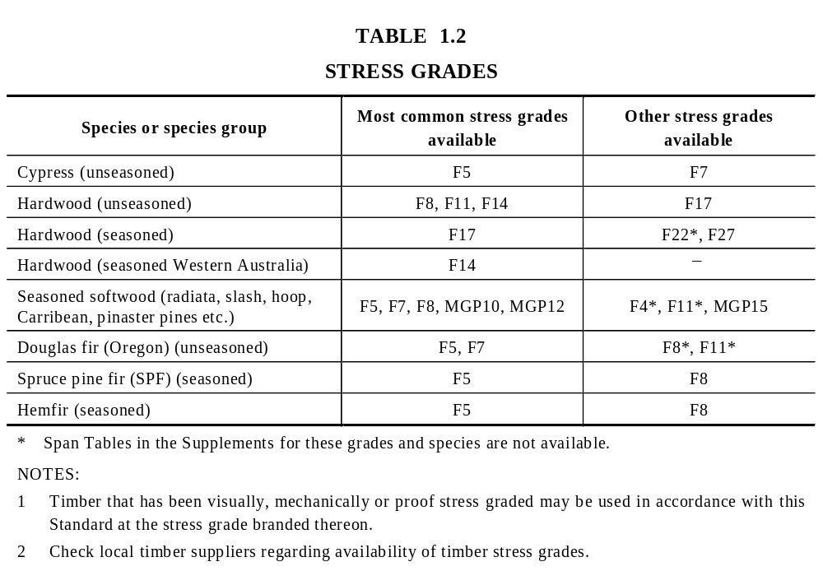

Slide 111
1.14 ENGINEERED TIMBER PRODUCTS
Fabricated components such as roof trusses, glued-laminated timber members, I-beams, laminated veneer lumber and nail-plate-joined timber may be used where their design is in accordance with AS 1720.1 and their manufacture and use complies with the relevant Australian Standards.

Slide 112
1.14 ENGINEERED TIMBER PRODUCTS
NOTE: In some situations, there are no relevant Australian Standards applicable to the design, manufacture or use of engineered timber products.
In such cases, the use of these products in accordance with this Standard is subject to the approval of the regulatory authority and the recommendations of the specific manufacturer who may require provisions additional to those contained in this Standard.
These may include but are not restricted to additional support, lateral restraint, blocking, and the like.

Slide 113
When designing and using engineered products, the specific manufactures span tables and installation information should always be used.
Span tables and installation information will generally vary between manufactures so if products are substituted, be sure that the correct span tables and installation information is used.

Slide 114
1.15 SIZE TOLERANCES
When using the Span Tables of the Supplements, the following maximum undersize tolerances on timber sizes shall be permitted:
  Unseasoned timber ⎯
    Up to and including F7 4 mm.
    F8 and above 3 mm.
  Seasoned timber ⎯ All stress grades 0 mm.
NOTE: When checking unseasoned timber dimensions on-site, allowance should be made for shrinkage, which may have occurred since milling.

Slide 115
The stress grading rules for timber also allow for a positive tolerance of +3 mm for all unseasoned timber and +2 mm for seasoned timber.
These tolerances are to allow for the wear and movement of saw and/or planning blades during manufacture.

Slide 116
1.16 ALTERNATIVE TIMBER DIMENSIONS
The alternative timber dimensions given by this Clause shall not apply to the Span Tables in the Supplements.
Where a timber dimension is stated in the clauses of this Standard, it refers to the usual minimum dimensions of seasoned timber. Alternative nominal dimensions for unseasoned timber and seasoned Western Australian hardwood shall be in accordance with Table 1.3.
The size tolerances given in Clause 1.15 are also applicable to these dimensions
A4

Slide 117
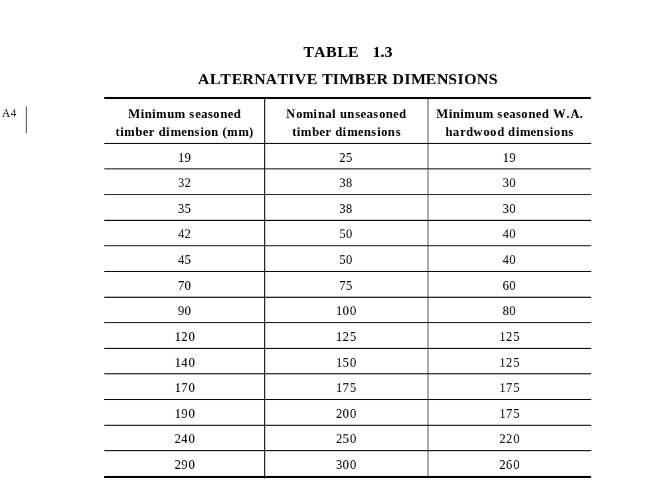
A4

Slide 118
1.17 GUIDELINES FOR DESIGN USING THIS STANDARD
Prior to using this Standard, the design gust wind speed and corresponding wind classification shall be determined and shall include consideration of terrain category building height and topographic and shielding effects (see Clause 1.6). The wind classification is the primary reference used throughout this Standard.

Slide 119
1.17 GUIDELINES FOR DESIGN USING THIS STANDARD
NOTE: The recommended procedure for designing the structural timber framework is to firstly determine the preliminary location and extent of bracing and tie-down and then the basic frame layout in relation to the floor plan and the proposed method of frame construction.

Slide 120
1.17 GUIDELINES FOR DESIGN USING THIS STANDARD
NOTE (cont’d): Individual member sizes are determined by selecting the roof framing timbers and then systematically working through the remainder of the framework to the footings, or by considering the floor framing through to the roof framing.

Slide 121
1.17 GUIDELINES FOR DESIGN USING THIS STANDARD
NOTE (cont’d): Bracing and tie-down requirements should also be considered when determining the basic frame layout to ensure any necessary or additional framing members are correctly positioned. The flow chart shown in Figure 1.7 provides guidance.

Slide 122
Although the following flow chart suggests that Member Sizes be determined before Bracing and Tie-down, there are good reasons for determing Bracing first then Tie-down and finally Member Sizes.
The reasons are as follows:-

Slide 123
Some Bracing systems affect member sizes (see Table 8.18 (i)) so if these member sizes have already been determined they will need to be re-sized.
Also
Some bracing systems may be able to used for Tie-down so if the bracing has been calculated and distributed, this can be taken into consideration for the Tie-down requirements.

Slide 124
Some Tie-down methods affect member sizes Table 9.16 (c), (i), (j), (k), (l), 9.20 (g), (i), (j), etc) so if these member sizes have already been determined they will need to be re-sized.
Member sizes can now be determined with a greater confidence that any possible limiting factors associated with bracing and tie-down have been considered.

Slide 125
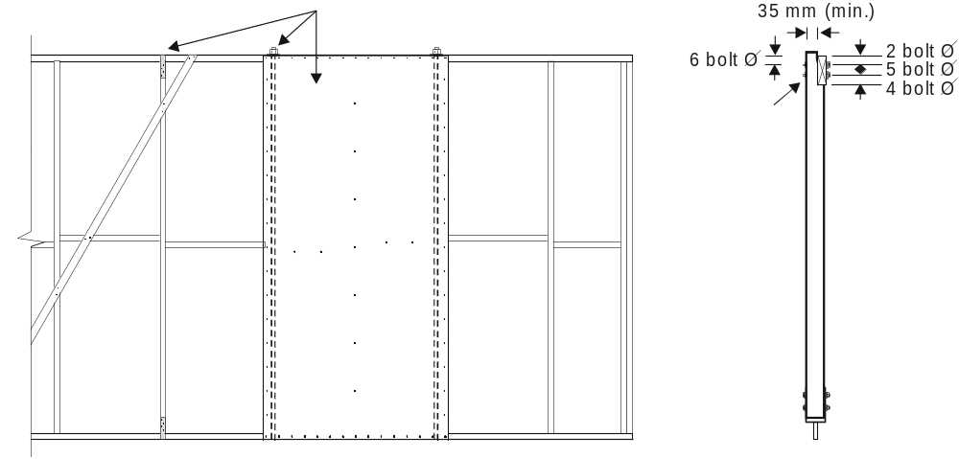
1. Bracing may affect top and/or bottom plate sizes and/or stud spacing.
2. Bolts or straps associated with braces or bracing sheets themselves may be able to be utilised for tie-down.
3. Tie-down methods may affect member sizes
Verandah beam
to post.
Table 9.20(i)

Slide 126
FLOW CHART FOR DESIGN USING THIS STANDARD
Reference
After determining the maximum design gust wind velocity, (refer to AS 1170.2 or AS 4055 or the relevant authority), refer to Table 1 for wind classification.
Sections 8 and 9
Section 1
DETERMINE WIND CLASSIFICATION
N1 TO N4
CONSIDER PRELIMINARY LOCATION AND EXTENT OF BRACING AND TIE — DOWN SYSTEMS AND MODIFY FRAMING LAYOUT IF REQUIRED
ESTABLISH BASIC FRAME LAYOUT AND METHOD OF CONSTRUCTION - FLOOR FRAME, WALL FRAME AND ROOF FRAME, INCLUDING LOAD PATHS, CANTILEVERS, OFFSETS ETC.

Slide 127
FLOW CHART FOR DESIGN USING THIS STANDARD
(cont’d)
Reference
Floor frame — Section 4
Wall frame — Section 6
Roof frame — Section 7
Section 8
Section 9
DETERMINE INDIVIDUAL MEMBER SIZES
DESIGN BRACING SYSTEM
DESIGN TIE-DOWN AND OTHER CONNECTION REQUIREMENTS

Slide 128
1.18 INTERPOLATION
Interpolation shall be made in accordance with Appendix D.

Slide 129
APPENDIX D
INTERPOLATION
Interpolation shall be made in accordance with Appendix D.

